Slide 1
Document Template Identification and Data Extraction using Machine Learning and Deep Learning Approach
Thesis Group - T2310001
Supervisor
Dr. Md. Khalilur Rahman
Professor
Department of Computer Science and Engineering
Brac University
Kaushik Roy | 20101185
Md Fuad Islam | 20101060
Md Minhazul Islam Rimon | 20101078
Tasnim Mobarak | 20101296
Mysha Samiha Priota | 20301205

Slide 2
Topics
Introduction
Related Work
Dataset
Methodology
Implementation
Result and Analysis
Conclusion and Future Work
Reference

Slide 3
Introduction

Slide 4
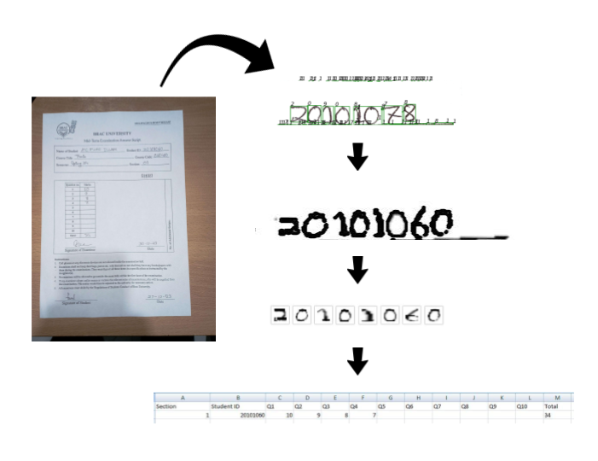
Introduction:
A technologically advanced tomorrow awaits.
The increasing demand for quick data processing.
Moving data from paper to computers is laborious and reduces efficiency.
Our goal: Making this process fast and efficient by directly converting the information of the manually checked scripts into digital data.

Slide 5




Related Work:
CNN with deep descriptor. (Zhengchao et al.[1])
Adamax, a first order gradient based optimization method. (Shubham et al.[2] )
Geometric rectification, pre- processing, image detection, text extractions. (Himank et al.[3])
LSTM( Long Short- Term Memory). (Jyothi et al. [4])
CNN with deep descriptor. (Zhengchao et al.[1])
Adamax, a first order gradient based optimization method. (Shubham et al.[2] )
Geometric rectification, pre- processing, image detection, text extractions. (Himank et al.[3])
LSTM( Long Short- Term Memory). (Jyothi et al. [4])

Slide 6
Dataset

Slide 7
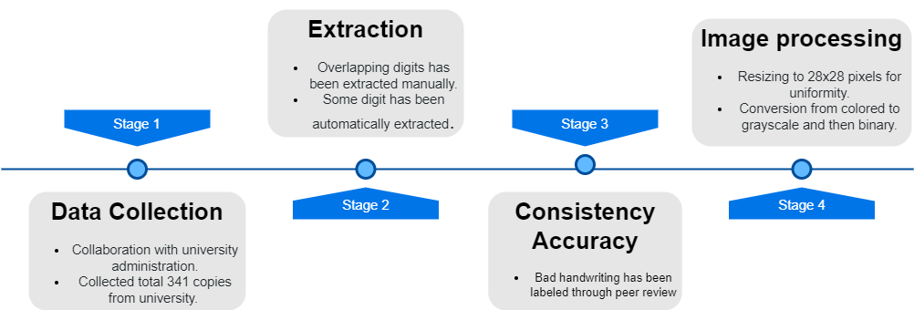
Dataset Creation
Fig: Data Creation Timeline

Slide 8



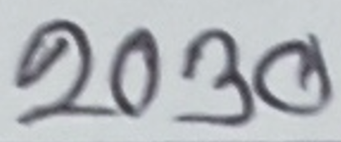
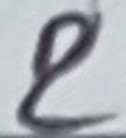





The Problems
Bad Handwriting
Overlapped

Slide 9
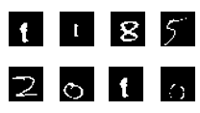
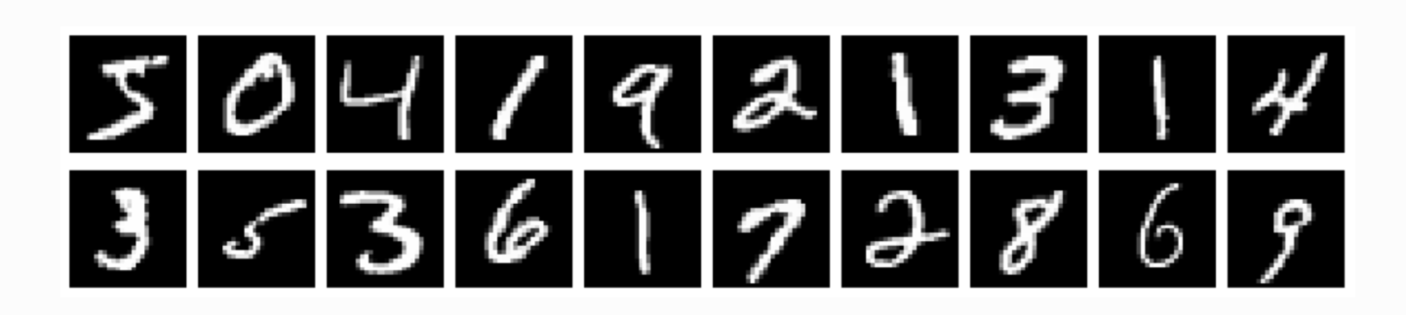
Dataset:
Primary Dataset
Primary dataset:
Total data size: 7118
Secondary dataset: MNIST dataset
Total data Size: 70,000 (Training - 60,000, Testing - 10,000)
Digit | Train | Test
0 | 1425 | 252
1 | 708 | 125
2 | 910 | 161
3 | 802 | 142
4 | 338 | 60
5 | 375 | 66
6 | 374 | 66
7 | 301 | 53
8 | 347 | 61
9 | 469 | 83

Slide 10
Methodology

Slide 11
Methodology:
3 Machine Learning Models and 2 Deep Learning models have been chosen
Machine Learning Models have been prepared for implementation in any environment.
Deep Learning Models have been chosen for better performance.

Slide 12
KNN
SGDClassifier
Nearest Neighbor have been Set to 3.
Weights has been set to ‘distance’.
Loss is set to ‘hinge’ type
Tolerance has been set turned off
Warm start has been turned on.
SVM
Kernel set to ‘rbf’ mode
Cost Parameters set to 10
Gaussian Width set to 0.01

Slide 13
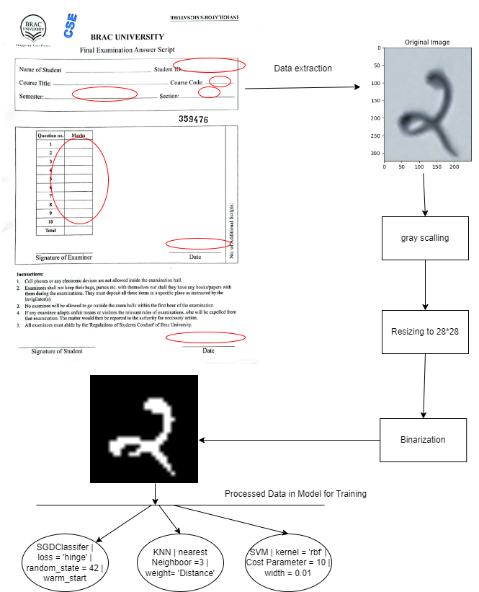

Slide 14
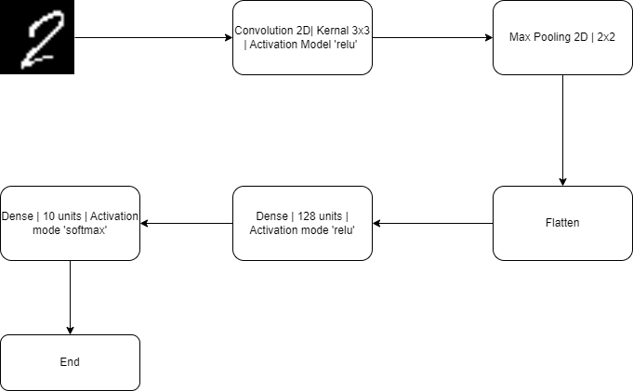
CNN

Slide 15
YOLOv8
Most advance model for image classification
Model’s mode has been kept default mode
AdamW optimizer has been used
Learning Rate set to 0.000714
Momentum has been set to 0.9

Slide 16
Implementation

Slide 17
Steps of Model Interface Implementation
01
Fix Image Orientation
Pre-process image.
Find quadrilateral points using hough lines.
Extract document using said points.
02
Extract Data Region
03
Segmentation on Extracted Data Regions
Segment using contours.
Remove anomaly.
04
Classify Using Chosen OCR Model
Pre-process segmented Image.
Classify using model.
05
Verification
Cross-check predicted id and database.
Store cropped image if predicted id is invalid.
06
Generate CSV File

Slide 18
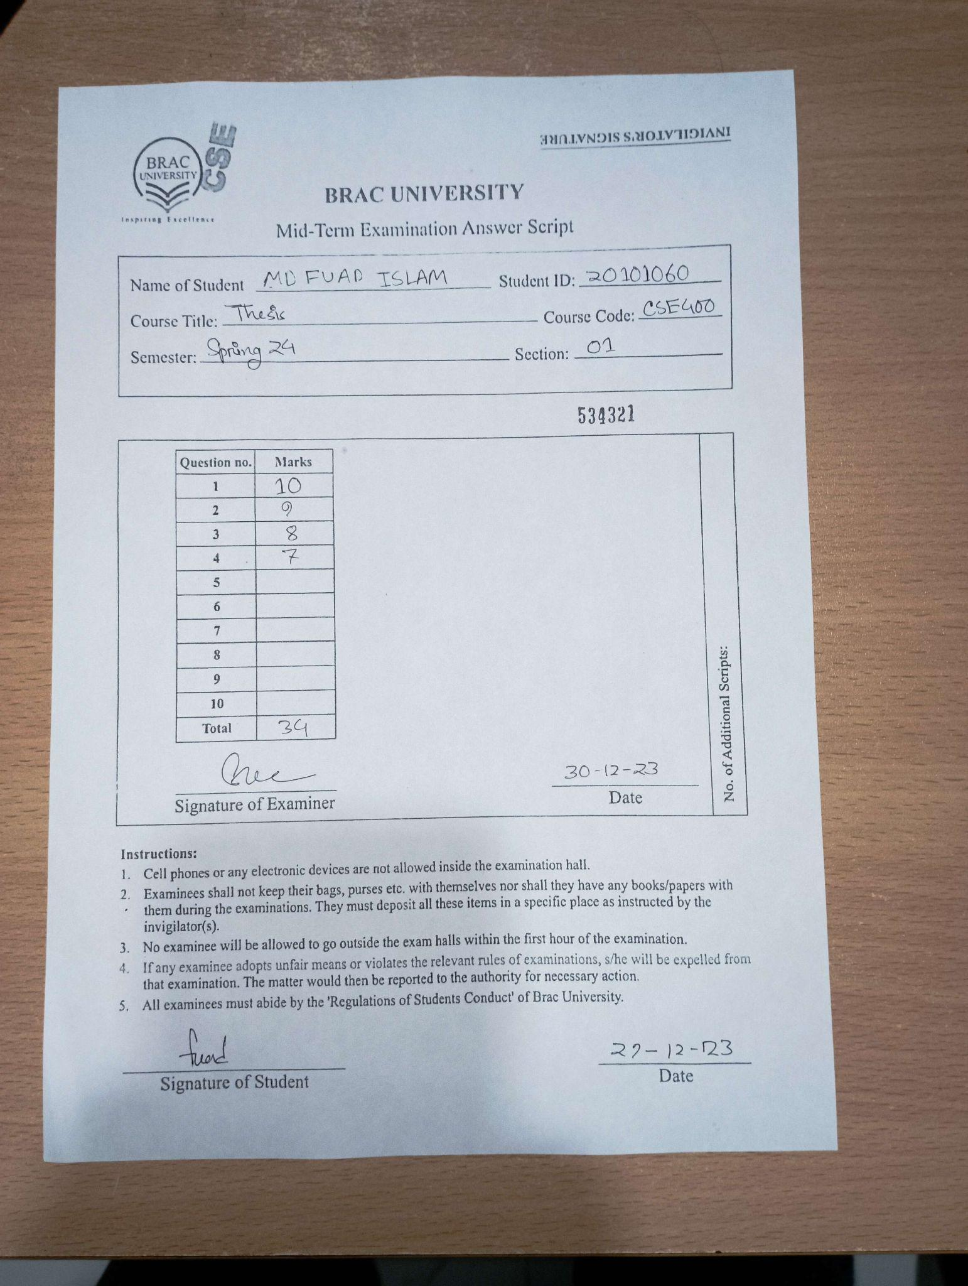
Step 1:
Fix image orientation.
Pre-processing
Finding quadrilateral using hough lines
Extracting quadrilateral using warp perspective function
Extract data regions.
FIg: Input Image

Slide 19
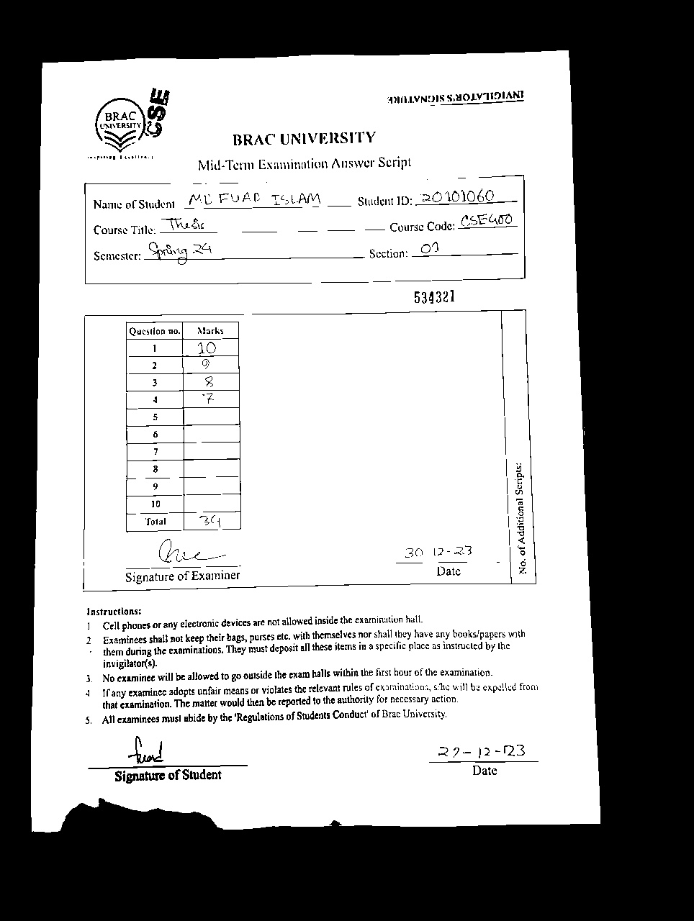
Step 1:
Fix image orientation.
Pre-processing
Finding quadrilateral using hough lines
Extracting quadrilateral using warp perspective function
Extract data regions.
Fig: Processed Image

Slide 20
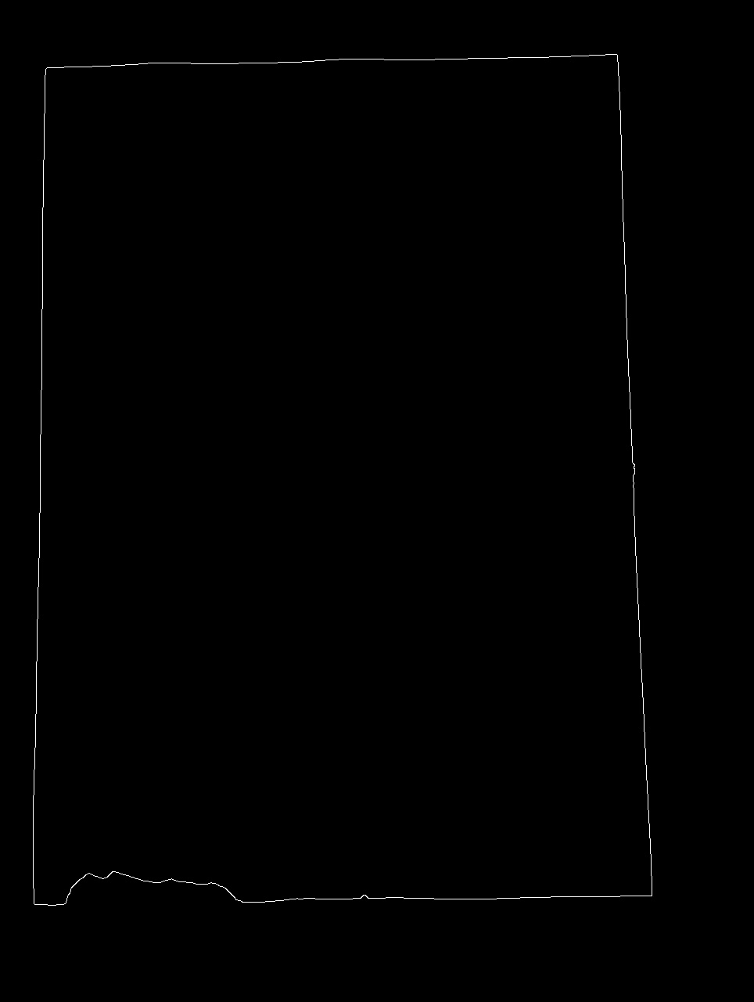

Step 1:
Fix image orientation.
Pre-processing
Finding quadrilateral using hough lines
Extracting quadrilateral using warp perspective function
Extract data regions.
Fig: Transformed Image

Slide 21
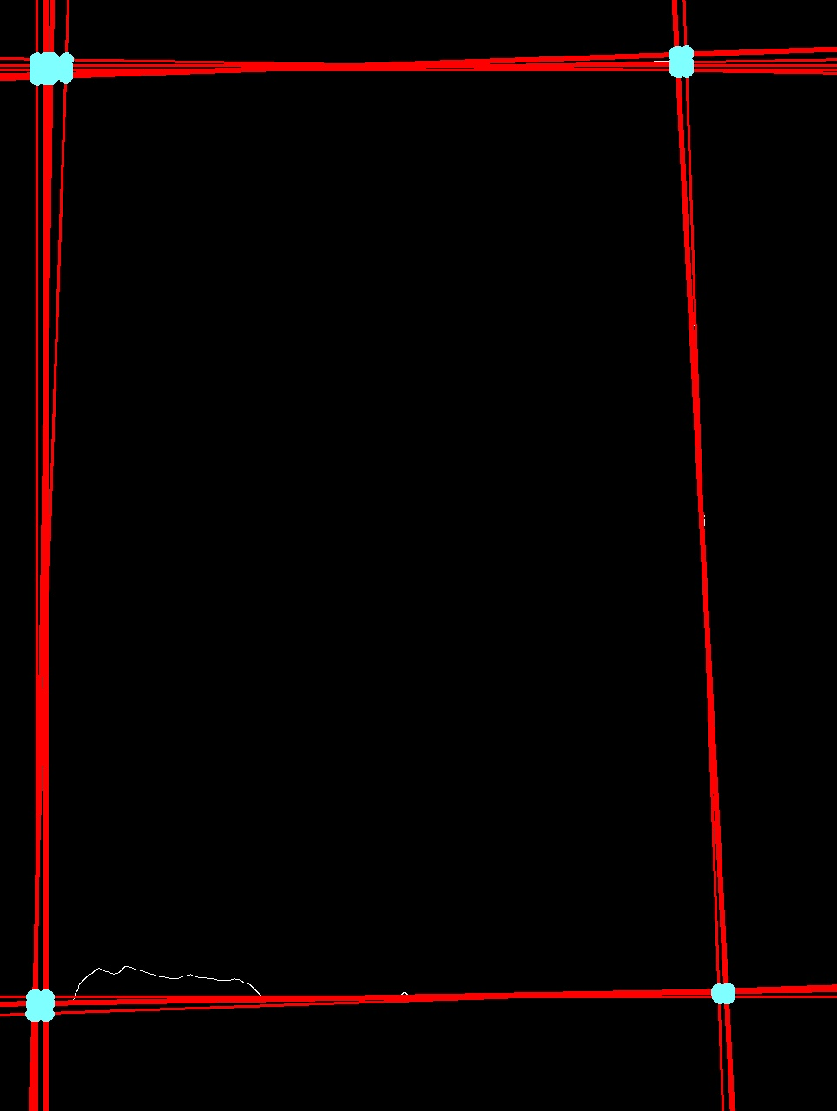
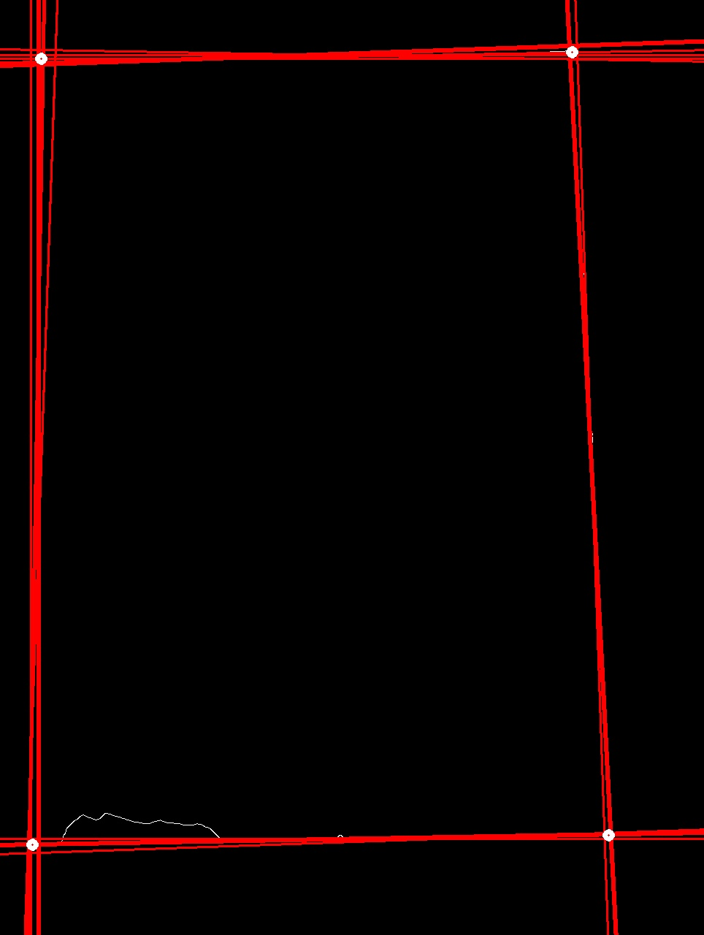
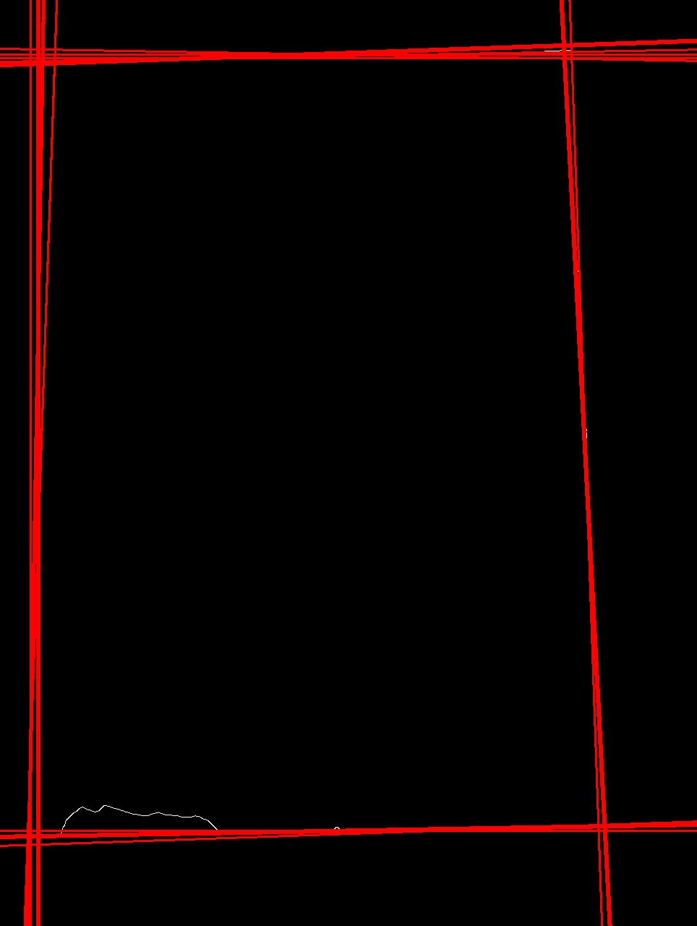
Step 1:
Fix image orientation.
Pre-processing
Finding quadrilateral using hough lines
Extracting quadrilateral using warp perspective function
Extract data regions.
Fig: Hough Line Implementation.

Slide 22
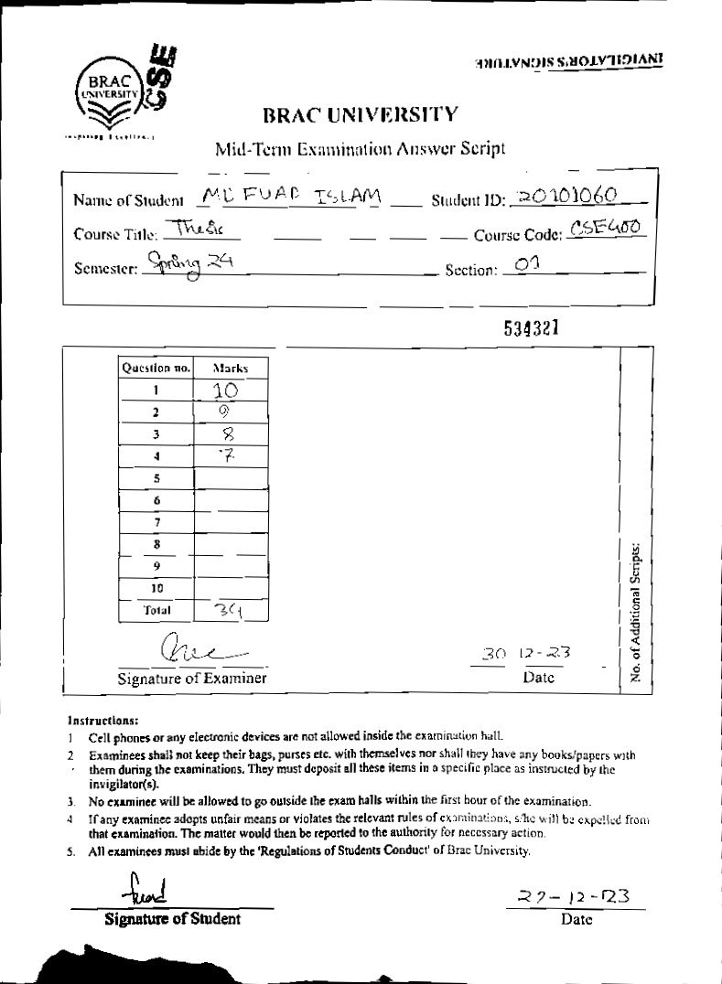
Step 2:
Fix image orientation.
Pre-processing
Finding quadrilateral using hough lines
Extracting quadrilateral using warp perspective function
Extract data regions.
Fig: Correctly Oriented Image

Slide 23
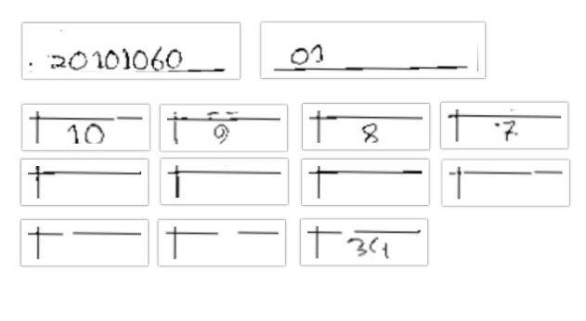
Step 2:
Fix image orientation.
Pre-processing
Finding quadrilateral using hough lines
Extracting quadrilateral using warp perspective function
Extract data regions.
Fig: Extracted Data Regions

Slide 24

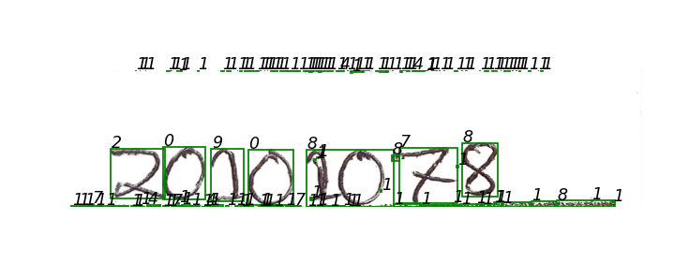
Step 3:
Fig: Contour Implementation on Cropped Image
Segmentation using contours
Perform segmentation.
Handling segmentation anomalies.
Prediction
Pre-process image
Fig: Finding borders using contours

Slide 25
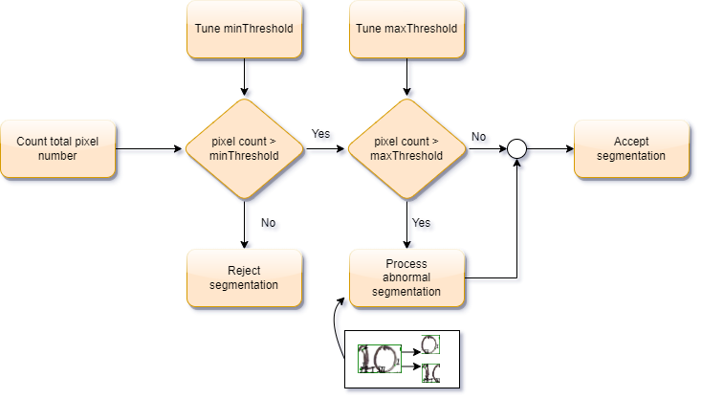
Step 3:
Segmentation using contours
Perform segmentation.
Handling segmentation anomalies.
Prediction
Pre-process image
Fig: Anomaly Handler

Slide 26


Step 4:
Segmentation using contours
Perform segmentation.
Handling segmentation anomalies.
Prediction
Pre-process image.
Fig: Training Data Representation.
Fig: Segmented Image

Slide 27
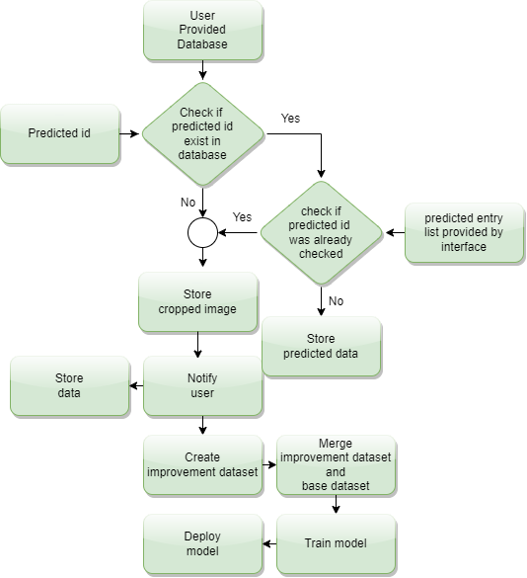
Step 5:
Verification
Fig: Verification Process

Slide 28
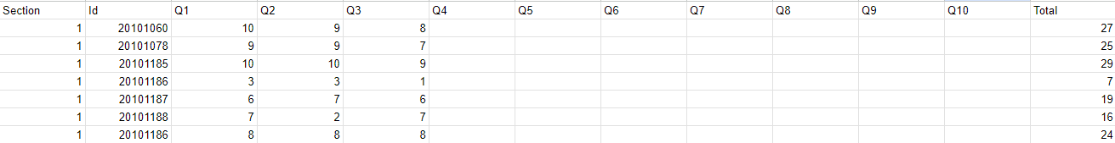
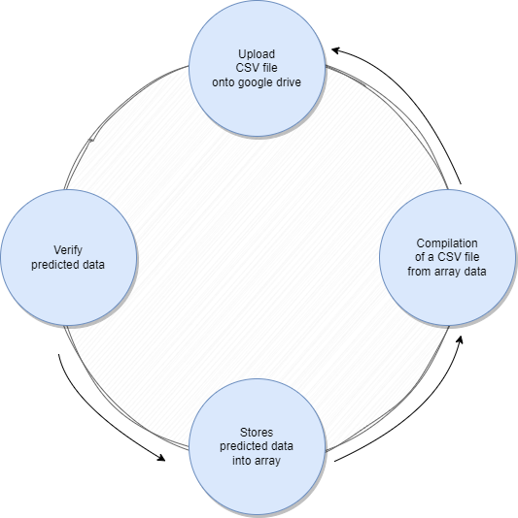
Step 6:
CSV compilation.
Fig: A Pseudo Output
Fig: CSV File Compilation

Slide 29
Result and Analysis

Slide 30
Result
Digits | KNN | SVM | SGDClassifier | CNN | YOLOv8
0 | 0.86 | 0.89 | 0.87 | 0.99 | 1
1 | 0.95 | 0.96 | 0.94 | 0.99 | 1
2 | 0.84 | 0.86 | 0.83 | 0.98 | 0.98
3 | 0.8 | 0.83 | 0.8 | 0.99 | 0.99
4 | 0.84 | 0.85 | 0.82 | 0.99 | 0.99
5 | 0.87 | 0.89 | 0.87 | 0.98 | 0.98
6 | 0.87 | 0.89 | 0.87 | 0.98 | 0.99
7 | 0.88 | 0.89 | 0.87 | 0.98 | 0.99
8 | 0.81 | 0.83 | 0.8 | 0.98 | 0.99
9 | 0.77 | 0.77 | 0.73 | 0.98 | 0.99
F1 score of the models

Slide 31
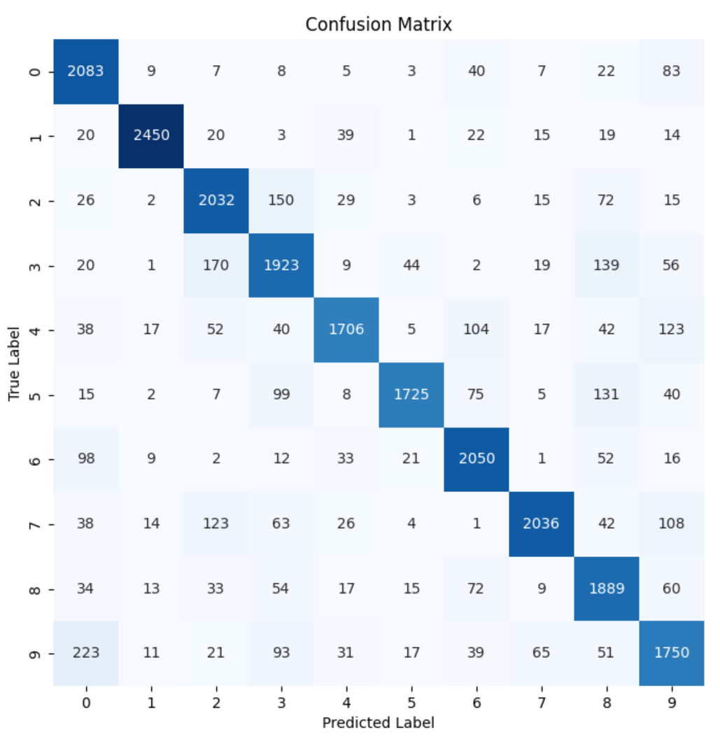
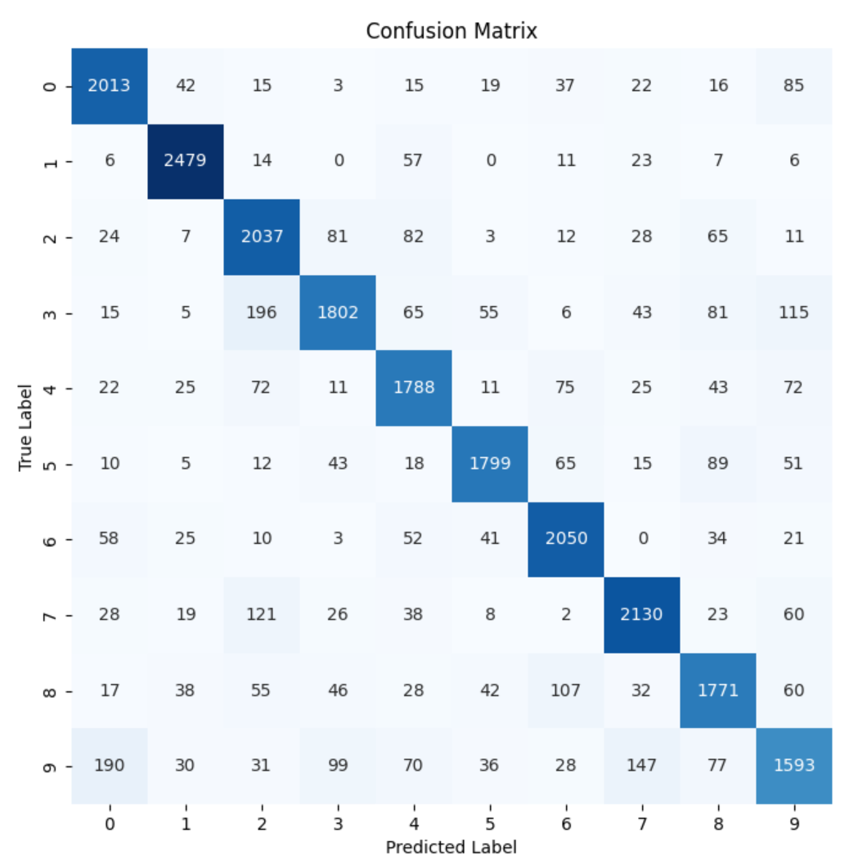
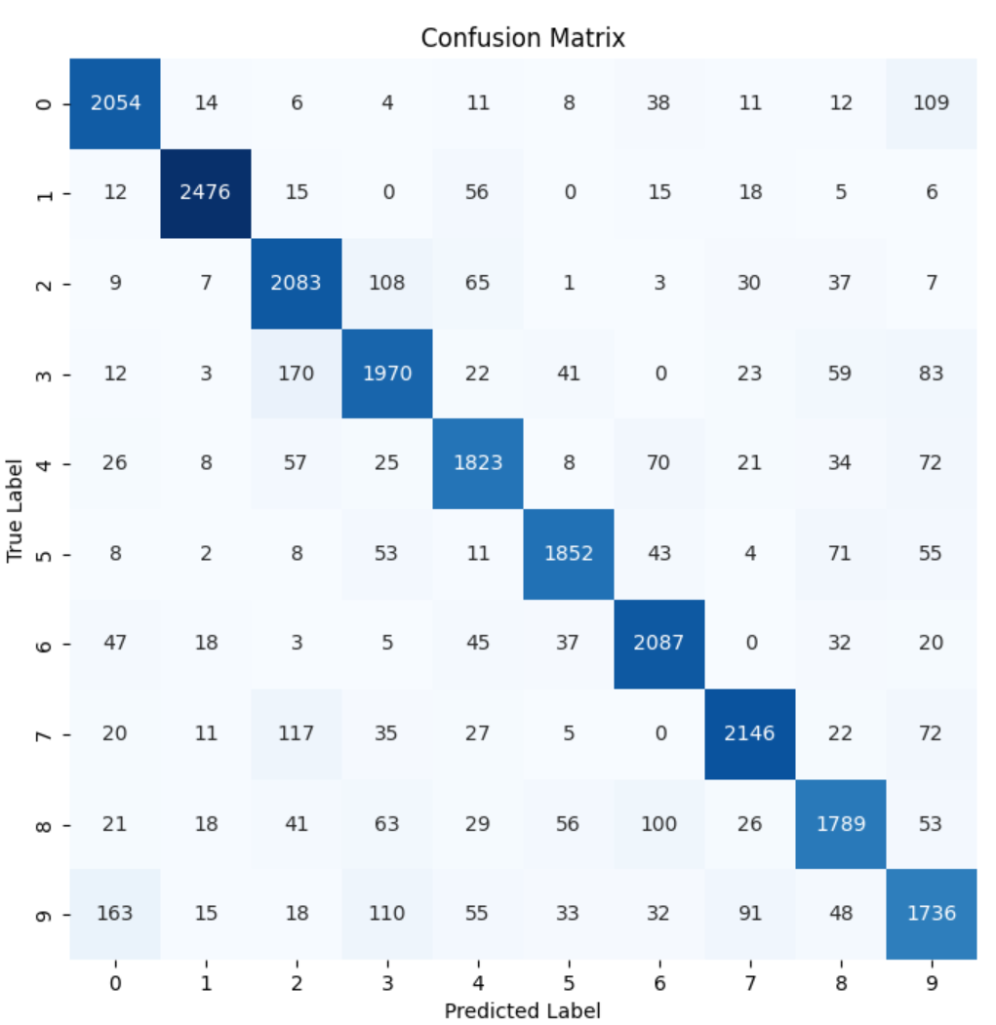
Result
KNN
SGDClassifier
SVM

Slide 32
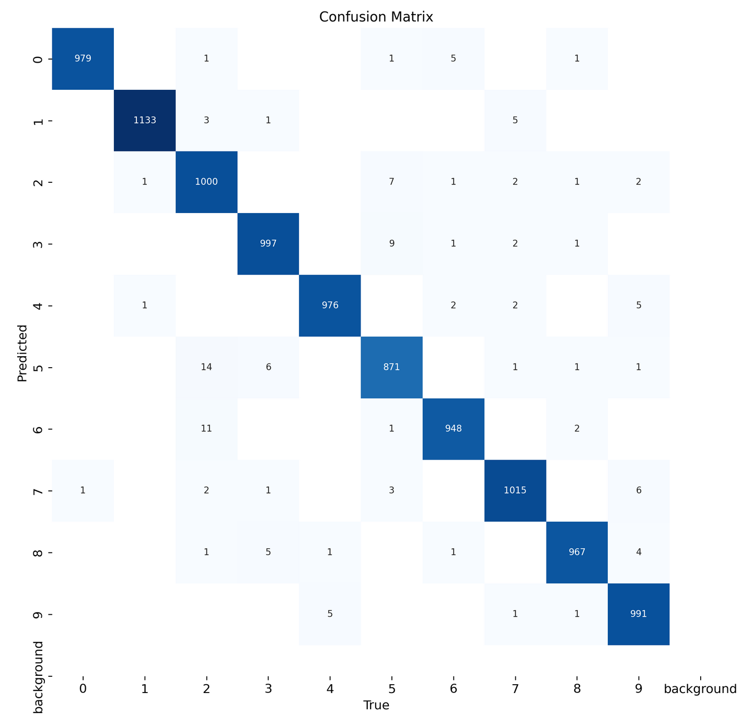
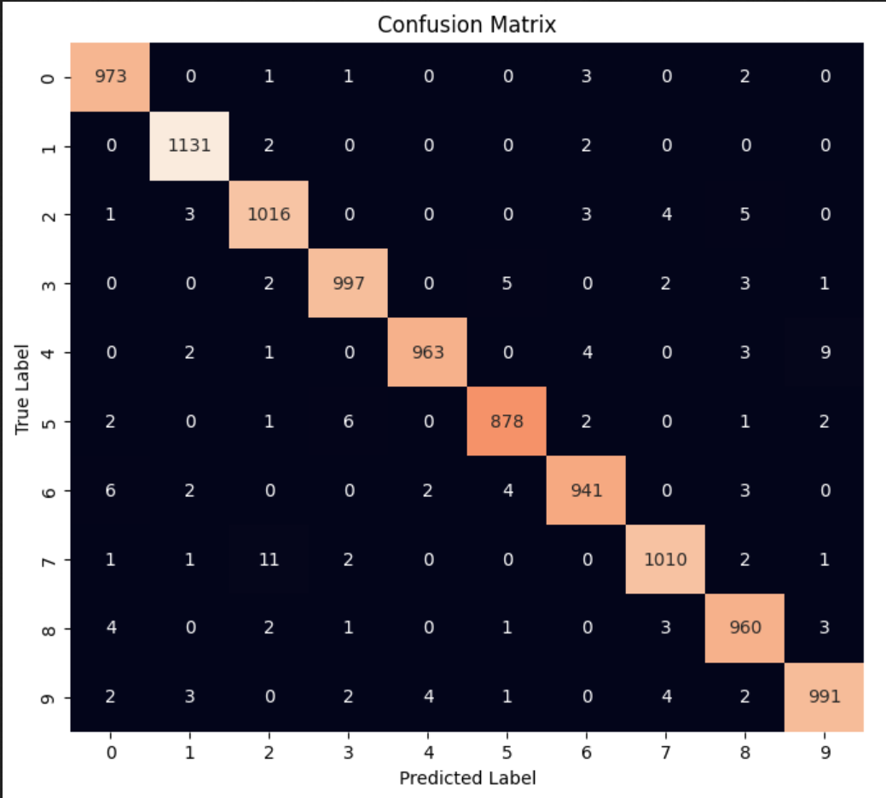
Result
YOLOv8
CNN

Slide 33
Result
Models | Accuracy
KNN | 85%
SGDClassifier | 84%
SVM | 87%
CNN | 98.6%
YOLOv8 | 98.8%
Overall Accuracy Comparison

Slide 34
Conclusion

Slide 35


Conclusion and Future Work
Dataset issue
Format making
Deployment
Fall ID 201, 211, 221, 231
Summer ID
202, 212, 222, 232
Fall ID
203, 213, 223, 233

Slide 36
Reference:
[1] Z. Lei, S. Zhao, H. Song, and J. Shen, “Scene text recognition using residual convolutional recurrent neural network,” Machine Vision and Applications, vol. 29, no. 5, pp. 861–871, 2018. doi: 10.1007/s00138-018-0942-y.
[2] S. S. Mor, S. Solanki, S. Gupta, S. Dhingra, M. Jain, and R. Saxena, “Handwritten text recognition: With deep learning and android,” International Journal of Engineering and Advanced Technology, vol. 8, no. 3S, pp. 819–825, Feb. 2019, ISSN: 2249-8958. [Online].
[3] H. Dave, “Ocr text detector and audio convertor,” International Journal for Research in Applied Science and Engineering Technology, vol. 8, no. 5, pp. 991–999, 2020. doi: 10.22214/ijraset.2020.5157.
[4] J. E. Tejaswini, “Text extraction from images using ocr,” International Journal for Research in Applied Science and Engineering Technology, vol. 8, no. 5, pp. 1805–1810, 2020. doi: 10.22214/ijraset.2020.5291.
[5] A. U, “Text localization and recognition,” International Journal for Research in Applied Science and Engineering Technology, vol. 8, no. 5, pp. 981–985, 2020. doi: 10.22214/ijraset.2020.5155.
[6] Y. Jiang, Z. Jiang, L. He, and S. Chen, “Text recognition in natural scenes based on deep learning,” Multimedia Tools and Applications, vol. 81, no. 8, pp. 10 545–10 559, 2022. doi: 10.1007/s11042-022-12024-w.
[7] S. Patil, V. Varadarajan, S. Mahadevkar, R. Athawade, L. Maheshwari, S. Kumbhare, Y. Garg, D. Dharrao, P. Kamat, and K. Kotecha, “Enhancing optical character recognition on images with mixed text using semantic segmentation,” Journal of Sensor and Actuator Networks, vol. 11, no. 4, p. 63, 2022. doi: 10.3390/jsan11040063.
[8] S. Xia, J. Kou, N. Liu, and T. Yin, “Scene text recognition based on twostage attention and multi-branch feature fusion module,” Applied Intelligence, vol. 53, no. 11, pp. 14 219–14 232, 2022. doi: 10.1007/s10489-022-04241-5.

Slide 37
Thank You All!!

